Slide 1
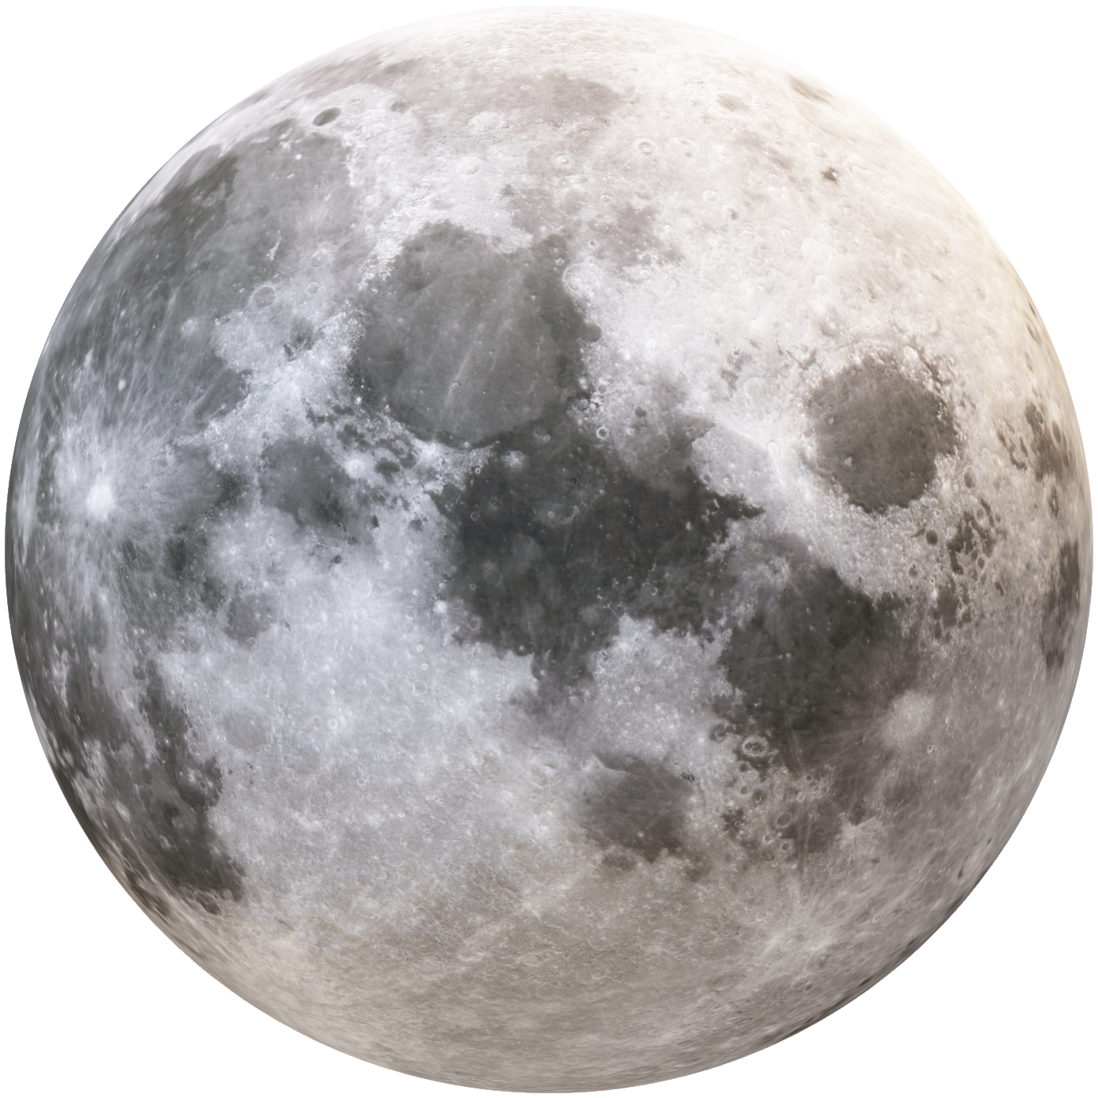

Duration: 105 min
Middle School
Grades: 6 - 8
CCSS, NGSS
Green After the Flames : How the Planet Recovers
Animation Celebration of Terra Satellite Data
Presented by: Bruce Pitt | Abraham Saenz | Ashish Khatri

Slide 2
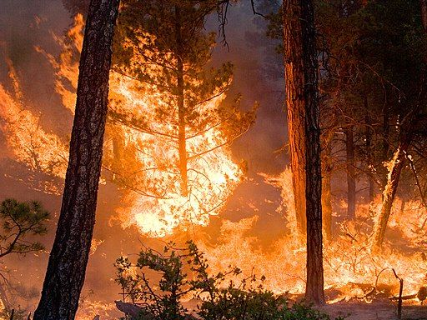
Green After the Flames : How the Planet Recovers
The Gila/Whitewater-Baldy Fire
297,000 acres burned in 2012
Forests gone, air thick with smoke, CO visible from space
Local communities displaced
Fig: Whitewater baldy night fire

Slide 3
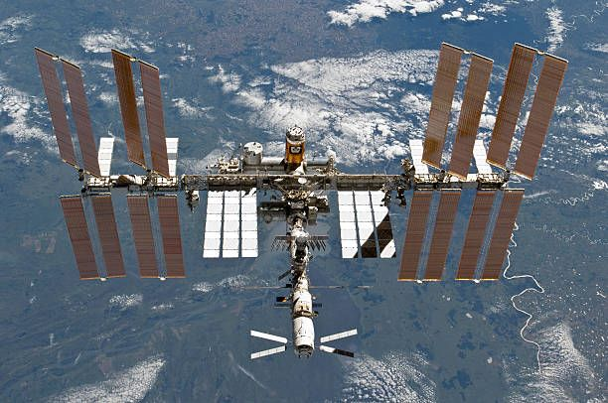
Green After the Flames : How the Planet Recovers
TERRA Satellite
Launched in 1999, produced data starting in 2000
Key Instruments:
MODIS (Moderate-Resolution Imaging Spectroradiometer)
MOPITT (Measurements of Pollution in the Troposphere)
CERES (Clouds and the Earth's Radiant Energy System)
ASTER (Advanced Spaceborne Thermal Emission and Reflection Radiometer)
MISR (Multi-angle Imaging Spectro Radiometer)
Fig: TERRA Satellite

Slide 4
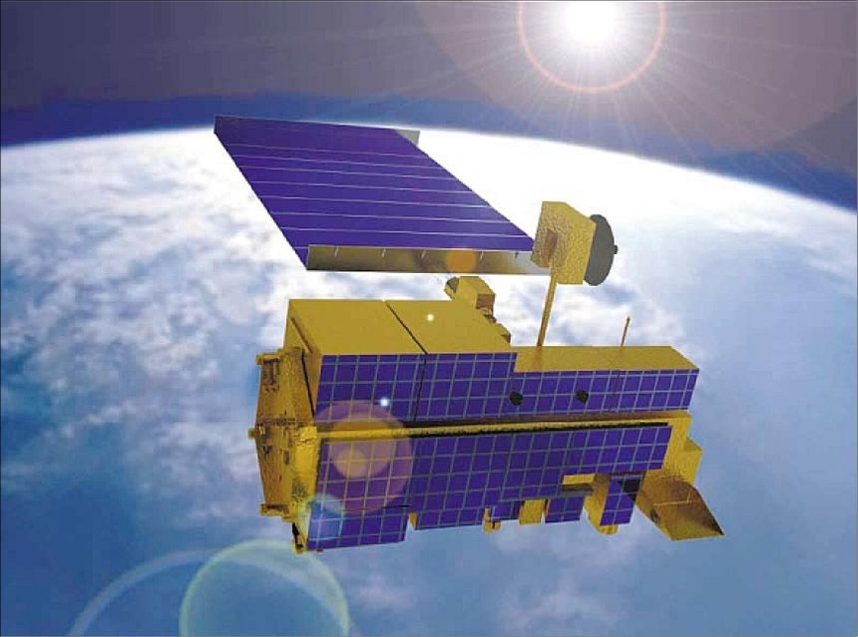
Green After the Flames : How the Planet Recovers
Goal: Track fire impact and recovery
Fire identification: FIRMS hotspot (MODIS data)
Burn Scar Mapping: FIRMS burn scar products
Vegetation Monitoring: NDVI/EVI from MODIS/MOD13 composites
Fig: Illustration of TERRA satellite

Slide 5
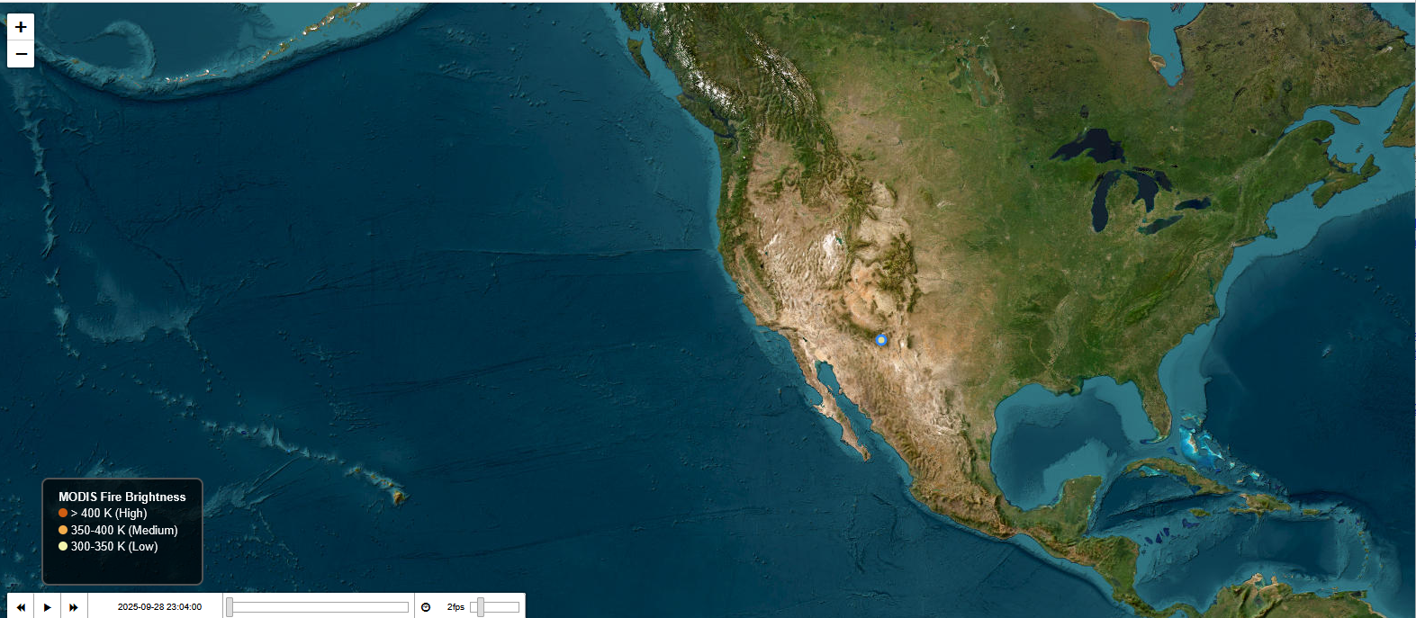
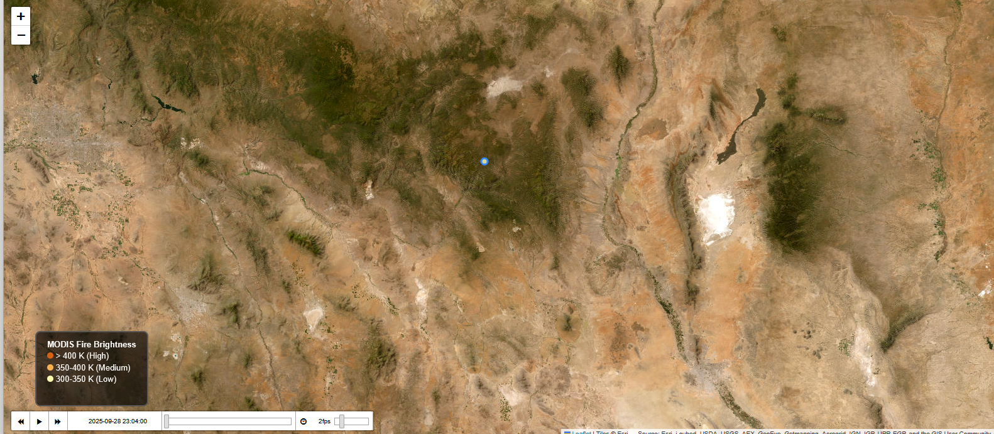
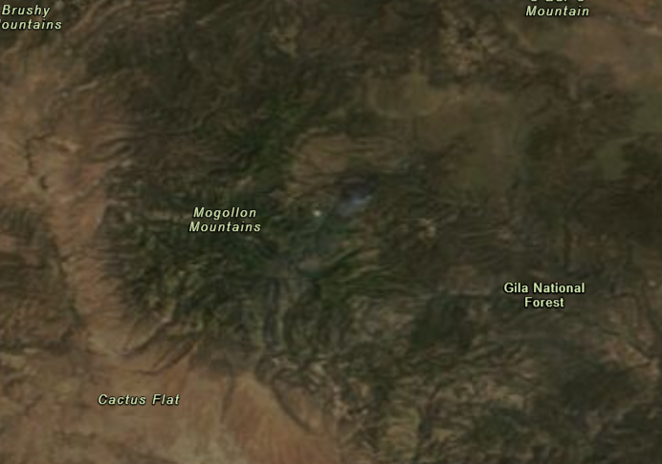
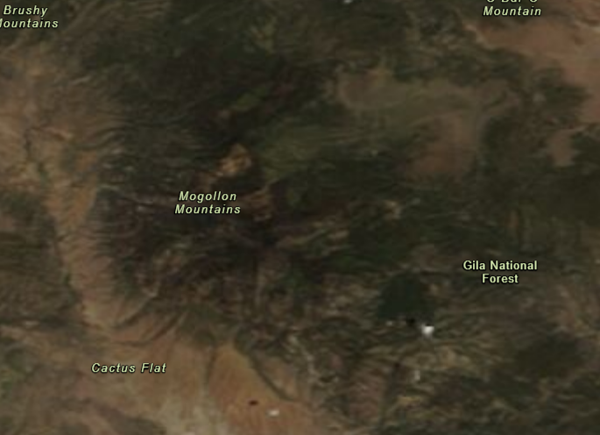
Green After the Flames : How the Planet Recovers
Fig: Satellite view of Gila
Fig: Fire detection in the map
Fig: Vegetation in the map 10 years later
Fig: Burn scars in the map

Slide 6
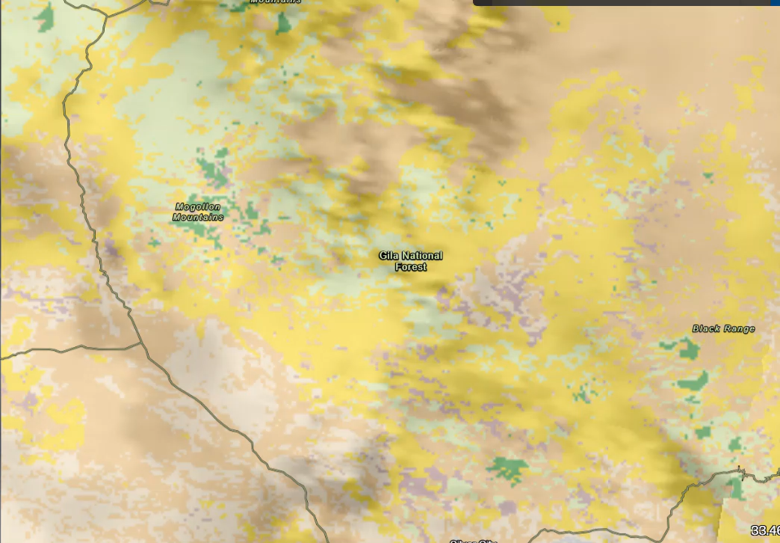
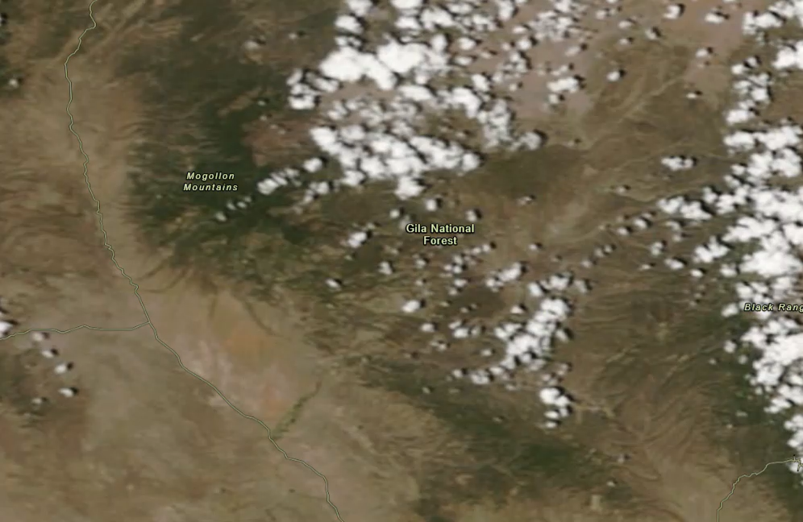
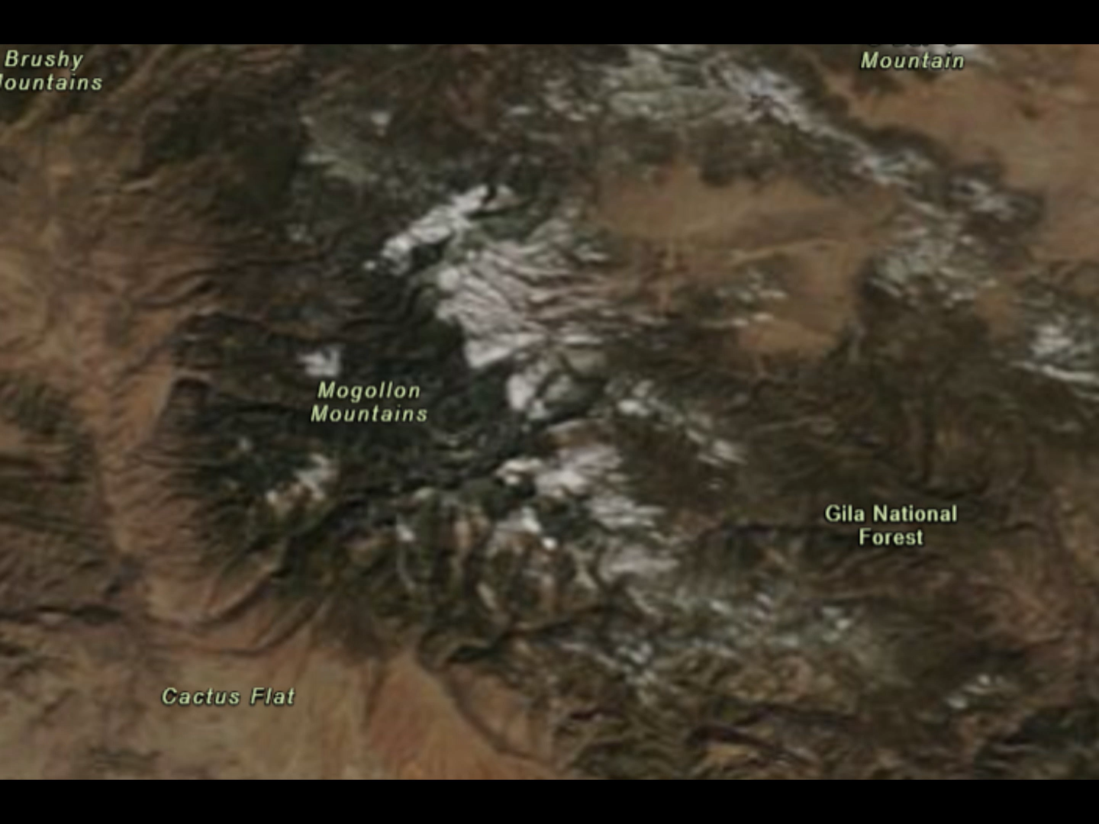
Green After the Flames : How the Planet Recovers
DEMO
Video: Fire radius recording
Video: Smoke & burns scars
Video: Vegetation Timelapse

Slide 7

Green After the Flames : How the Planet Recovers
Roadmap
Host via server: Make the workflow accessible online
Web frameworks: Canvas + Flask for interactive visualizations
Expand data: Integrate longer date ranges for trend analysis
Fig: Integration data system
Thank you

